Slide 1
CRAFTING COMPELLING WEB
PRESENCES
ANURUDH B A
MBT7

Slide 2




About Us
At HCLSoftware, we aim to empower businesses worldwide with the tools to navigate the digital transformation into the Digital+ Economy. We are united in our commitment to deliver best-in-class software and services.
We focus on the four pillars of the Digital+ Economy: Digital transformation, data & analytics, Al & automation, and enterprise security.

Slide 3


HCL Actian Data Platform
HCL
DataConnect
HCL Vector Analytics Database
HCL Zen Edge Data Management

Slide 4










Website Development
CMS
HCL Digital Experience
Data Base
My SQL
Drupal
Advertising
Google Ads
Word Press
Twitter Ads

Slide 5












Website Development
Analytics
Piwik PRO Core
Linkedin Insight Tag Google Analytics
Facebook Pixel Crazy Egg
Tag Managers
Google Tag Manager
Blogs
Word Press
Security
HSTS

Slide 6








Website Development
JavaScript Library
jQuery UI core-js
OWL Carousel jQuery FancyBox
UI frameworks
Bootstrap
JavaScript graphics
Highcharts

Slide 7


Website Development
Miscellaneous
Open Graph
Cookie compliance
OneTrust
Popper

Slide 8



Responsive Design and Mobile Optimization Evaluation
Mobile Optimization Analysis
Performance Metrics
First Contentful Paint: 618ms Time to Interactive: 2.9s Speed Index: 2.7s
Total Blocking Time: 565ms Largest Contentful Paint: 1.4s Cumulative Layout Shift: 0.58

Slide 9


Responsive Design and Mobile Optimization Evaluation
Top Issues:
High: Avoid enormous network payloads.
Total size was 7.29MB.
Med-High: Avoid an excessive DOM size.
There were 3,299 elements.
Med: Avoid large layout shifts. 5 elements found.
Med: Use explicit width and height on image elements. 42 images found.
Med: Serve static assets with an efficient cache policy. Potential savings of 5.98MB.

Slide 10
Recommendations
Optimize images to reduce page size and loading time.
Minify and defer JavaScript and CSS files to improve loading speed.
Consider using a CDN to distribute static assets and reduce server load.
Reduce the number of DOM elements to improve page rendering performance.
Address layout shift issues to enhance user experience, particularly on mobile devices.

Slide 11
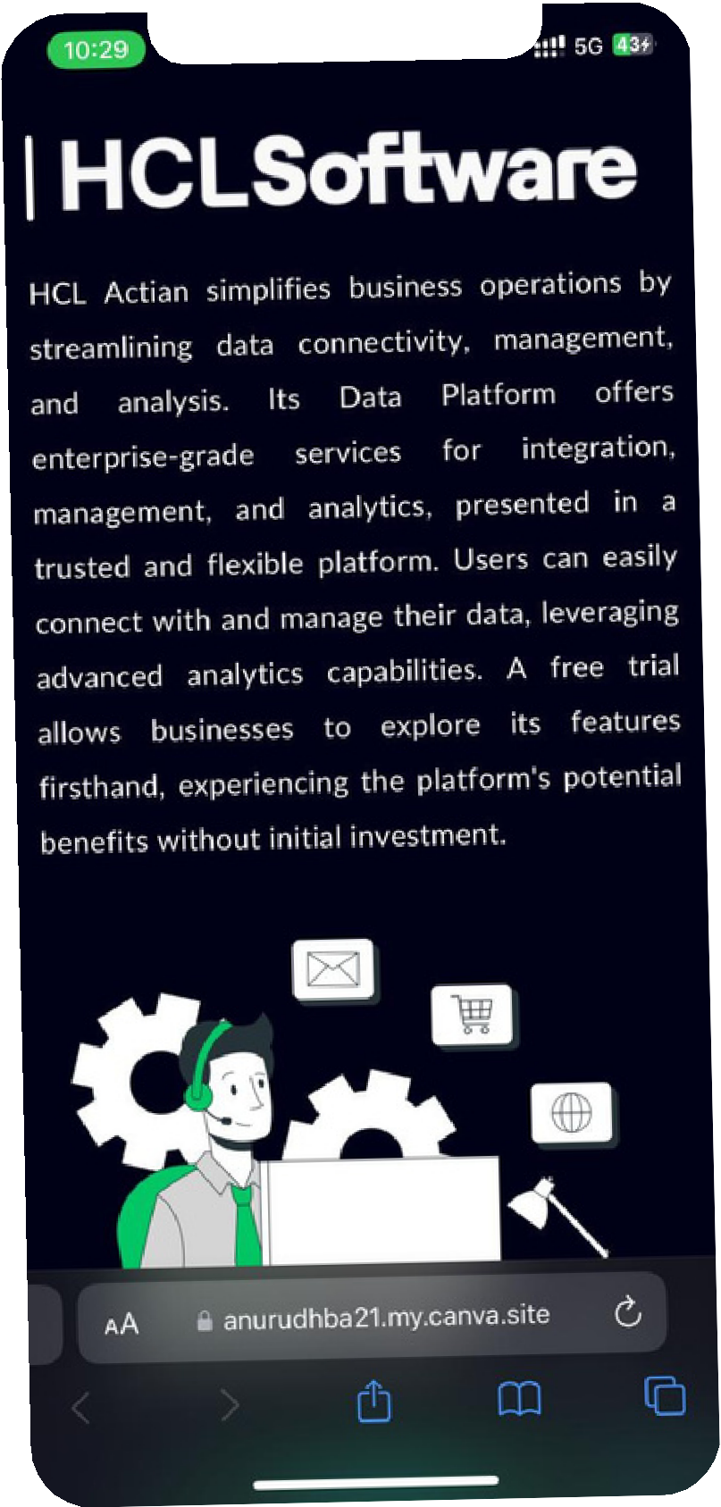


Landing page
Link for landing page

